Slide 1
Lipids
Fatty Acids
PUFA
Omega 3,6,9 FA

Slide 2

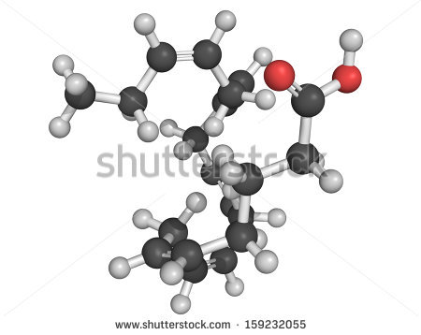
EICOSANOIDS
  A large group of autocoids
  Derived from eicosanoic acids

Slide 3
What Are they?
Prostaglandins
Thromboxanes
Prostacyclins
Leukotrienes
Lipoxins

Slide 4
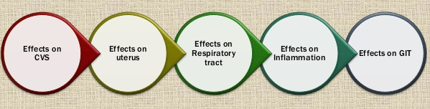
Significance
Diverse effect
Tissue specific
Most potent Biologically active substance
Some of them are similar to hormones
Use for therapeutic purpose
Need to inhibit in some conditions

Slide 5
Objectives
At the end of this lecture the student should be able to;
explain the biological actions of eicosanoids.
briefly explain the clinical significance of
eicosanoids.
describe briefly the pathway of synthesis of
eicosanoids

Slide 6
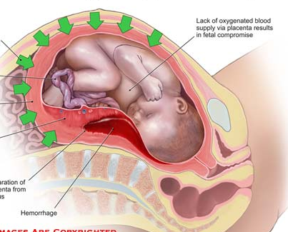
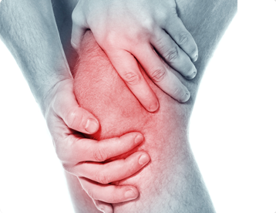
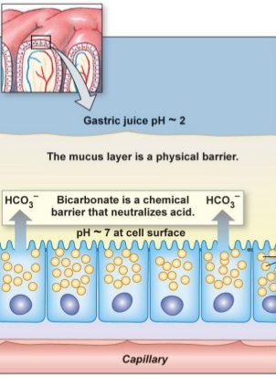
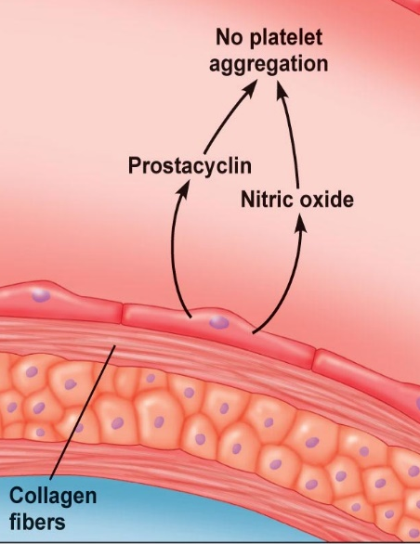
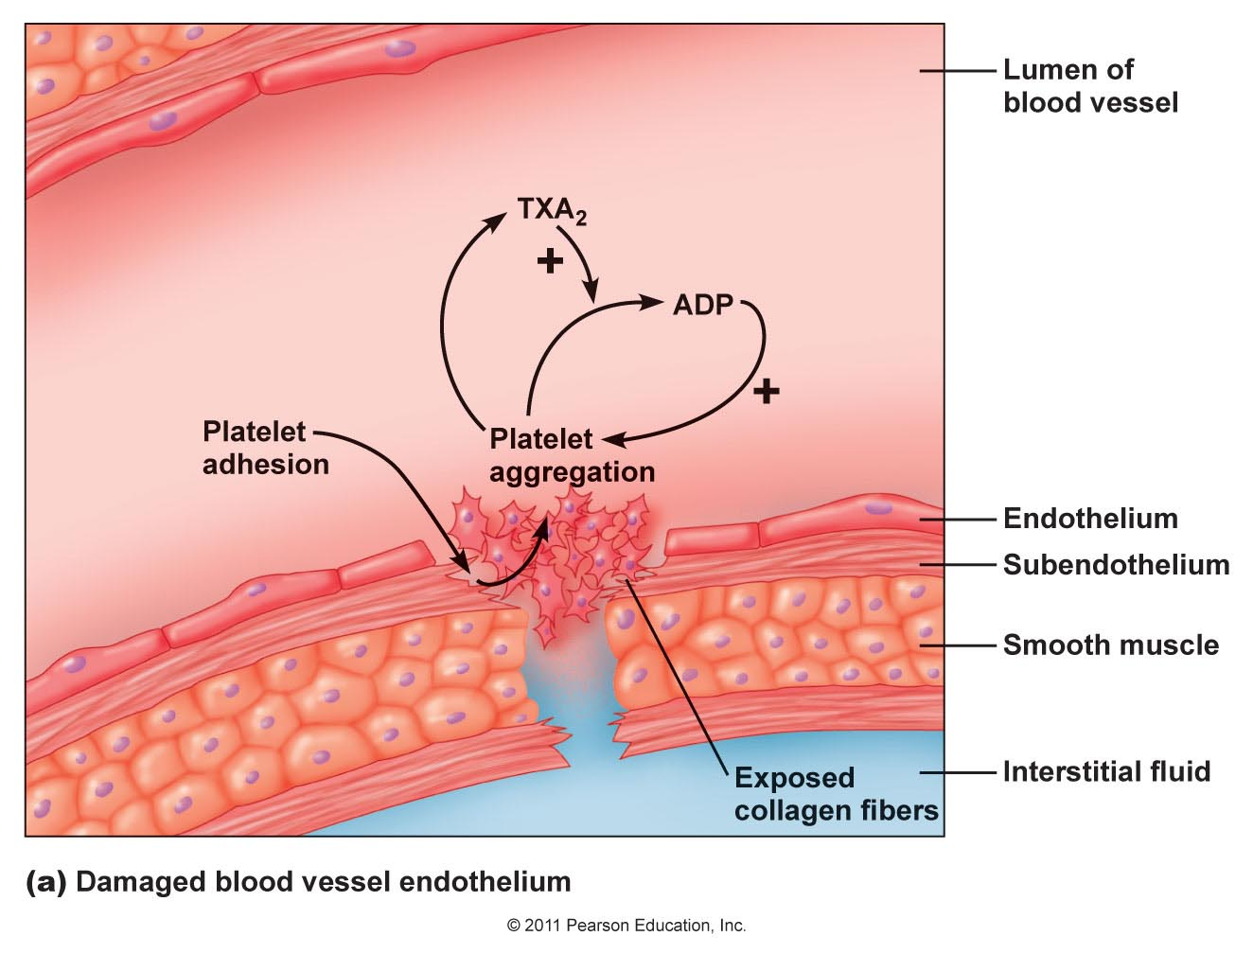

Slide 7
Effects
Induction of inflammation
Mediation of pain signals
Induction of fever
Smooth muscle contraction (including uterus)
Protection of stomach lining
Simulation of platelet aggregation
Inhibition of platelet aggregation

Slide 8
Classification
Prostanoids
Prostaglandins (PGs)
Leukotrines (LTs)
Lipoxins (LX)
Prostacyclins(PGIs)
Several series
A B E F –Attached groups
PGA1 PGA2 PGA3 – No of double bonds
Thromboxanes(TXs)

Slide 9
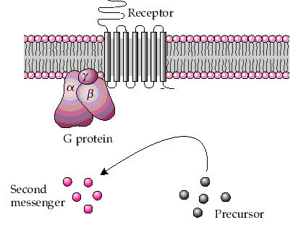
Biological action
Leads to change the concentration of second messenger (c-AMP, Ca⁺⁺,GMP)
Exception
Adipose tissue
Renal tubular cells

Slide 10
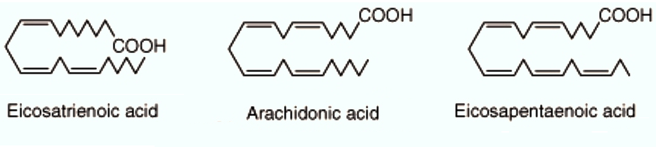
Precursors of Eicosanoids
Arachidonic acid (ω6)
Eicosatrienoic acid (γ-linolenic acid, linoleic acid ; ω6)
Eicosapentaenoic Acid (ω3)

Slide 11
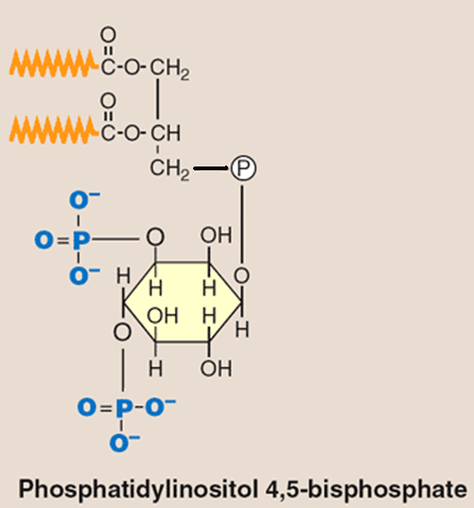
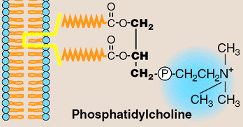
Dietary Linoleic Acid (C18: ∆^{9,12}) (from plant oils)
Elongase
Desaturase
Arachidonic Acid (C20: ∆^{5, 8, 11, 14})
Membrane Phospholipids

Slide 12
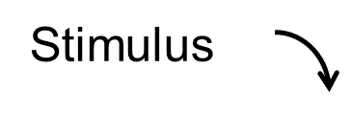
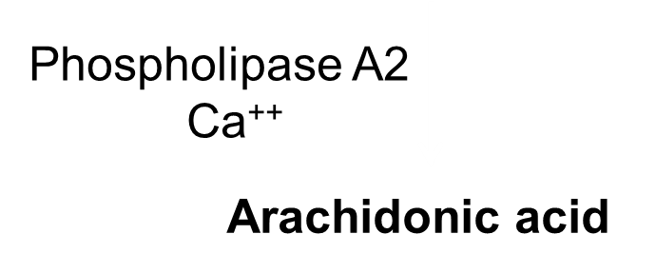
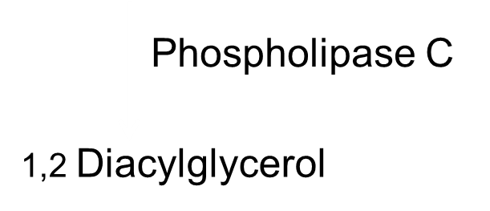
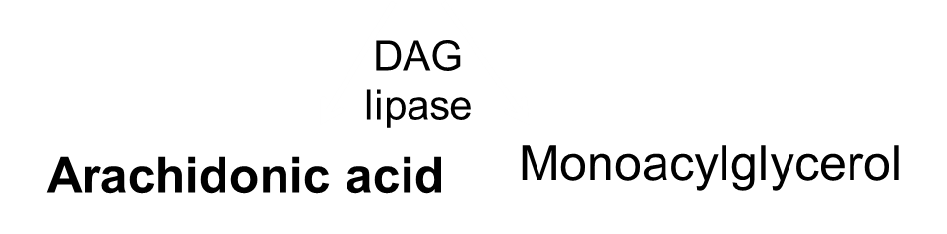
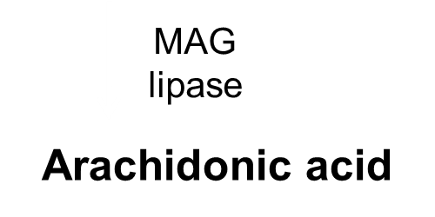
Arachidonic acid release from membrane lipids
Phosphatidyl choline
Phosphatidylinositol bisphosphate

Slide 13
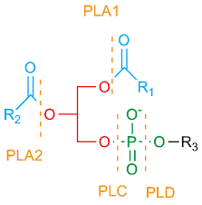

Slide 14
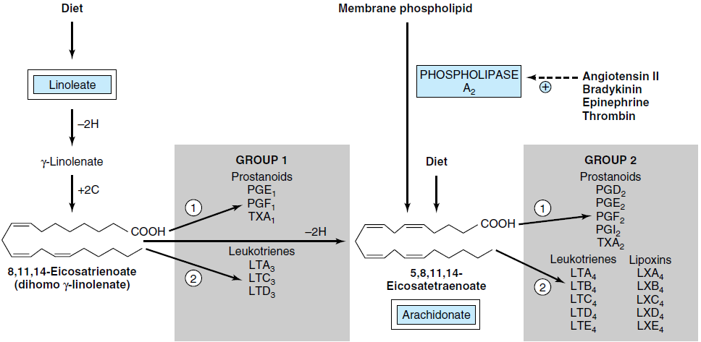
Groups of eicosanoids & their biological origin
Notes:
PGA, PGD, PGE, PGF, PGG, PGH, PGI
Depending on the functional groups present at X and Y
PGF _{1, 2} or ₃
Depending on the number of double bonds present in the linear hydrocarbon chain

Slide 15
Arachidonic Acid Metabolism
Arachidonic acid
Cyclo-oxygenase Pathway
lipoxygenase Pathway
PGG₂
HPETE
Prostaglandins
Leukotrienes
Lipoxins
Thromboxanes
HETE

Slide 16
Cyclooxygenase
Three isoforms COX 1
–Constitute expression
-Present in many normal tissue
COX 2
-Expression is highly regulated
-Induce by inflammatory stimulus
–present in inflamatory cells
COX 3
-present in brain
-Responsible for pain & fever

Slide 17
Anti inflammatory Drugs inhibit Eicosanoid Synthesis
Membrane lipids
Steroids
Phospholipase A2
NSAIDs
Arachidonic Acid
Cyclo-oxygenase
Lipoxygenase
Prostaglandins, thromboxanes
Leukotrienes

Slide 18
Inhibitors
Phospholipase A2 inhibitor -Corticosteroids
Cyclooxygenase inhibitor-
COX non specific inhibitor
Eg; Non Steroidal Anti Inflamatory Drugs
(NSAID), Asprin
Selective COX 2 inhibitor
Eg; Celecoxib

Slide 19
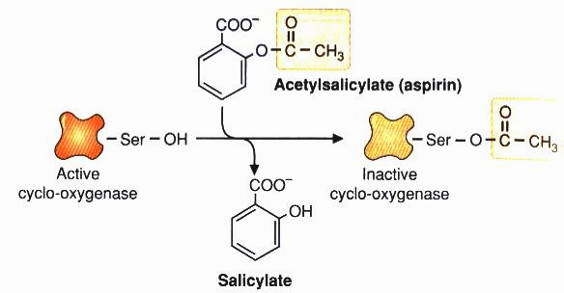
Mechanism of Aspirin Action

Slide 20
Leukotrienes
LTB4
↑ Vascular permeability, T-cell proliferation, leukocyte aggregation, IL -1, IL-2, IFN-γ
LTC4 and LTD4
↑ Bronchoconstriction, Vascular permeability, IFN-γ

Slide 21
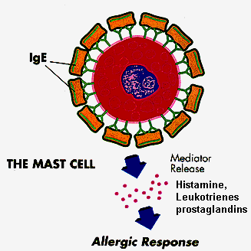
Leukotrienes and allergies
Leukotrienes are more potent than histamine
Histamine provided a rapid response to an allergen
In the later stages leukotrienes are principally responsible for
inflammation, smooth muscle constriction, constriction of the airways and mucous secretion form mucosal epithelium

Slide 22
cysteinyl leukotrienes LTC4 ,LTD4 & LTE4
Produce slow reacting substance of anaphylaxis
(SRS-A)
Lipoxins
Resolution of inflammation

Slide 23
Lipooxygenase inhibitor
Zileuton
Leukotriene antagonist
Montelukast, Zafirlukast

Slide 24
Clinical significance
Prostaglandins
Action | Clinical significance PG Inhibitors
Uterine muscle contraction PGE2,PGF2 | Induction of labour, Termination of pregnancy, Prevention of conception | Dysmenorrhea, Menorrhagia.
Inhibit gastric secretion PGE1 | Can use to prevent gastric ulcer | Elevate gastric secretions

Slide 25
Action | Clinical significance Inhibitors
Vasodilatation,Increses renal blood flow | Reduce renal blood flow, Renal failure
Contract bronchial musculature | Treatment of asthma of asthma
Natural mediator of inflammation & pain ( acute & chronic arthritis) | Treatment of inflammation & as a pain killer
Mediator of fever | As Antipyretics
Maintain the Ductus arterioses during intrauterine life. | Used to close DA in premature babies

Slide 26


Slide 27
Prostacyclins(PGI₂) Vascular endothelium | Thromboxanes A₂ Platelets
Increase c-AMP | Decrease c-AMP
Inhibit platelet aggregation Vasodilatation | Enhance platelet aggregation Vasoconstrictions
Smooth muscle relaxation | Smooth muscle Contraction

Slide 28
Eicosapentaenoic Acid (EPA)
ω- 3 fatty acids
Weaker aggregator
EPA
(Fish Oil)
PGI₃ and TXA₃
antiaggregator
3 series
Inhibit release of arachidonate
PGI₂ & TXA₂ formation impaired
2 series
Atherosclerosis low
Prolong clotting time

Slide 29
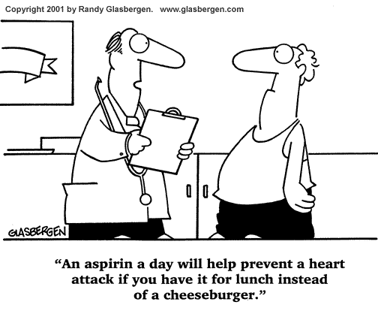
Aspirin and cardiovascular disease
Low dose aspirin has an anti -thromobogenic effect and lowers the risk of heart attacks and strokes.
It inhibits the formation of TXA2 in platelets, by inhibition of COX-1 which cannot be overcome because platelets have no nucleus.
Endothelial cells have a nucleus and synthesis more COX-1 enzyme needed for the normal prostaglandin functions

Slide 30
Aspirin is useful in the prevention of vascular thrombosis
Prostacyclin PGI₂ -Vascular endothelium
Inhibit the platelet aggregation
Thromboxane A₂ – platelets
Cause platelet aggregation
Aspirin specifically block the active site of cyclooxygenas & irreversibly inhibit the enzyme hens both eicosanoids.
Prostacyclin can immediately produce by endothelial cells
But mature platelets cant synthesize thromboxane.
It takes about 4 days for new platelets come into circulation.

Slide 31
Summary

Slide 32
Phospholipids
(-)
Phospholipase A2
Corticosteroids
Arachidonic acid
Corticosteroids
COX2 inhibitors
Celecoxib
(-)
(-)
5 -Lipoxygenase
COX1
NSAID
COX2
15-HPETE
Aspirin –irreversible
Others- reversible
PGG₂
peroxidase
IH
PGH₂
Lipoxin
5-HPETE
(5-hydroperoxyeicosatetraenoic acid)
TXA₂ (Thromboxane A₂)
PGE₂(prostaglandin E₂)
LTA₄ (Leukotriens A ₄)
PGF _{2α} (Prostaglandin F _{2α})
PGI₂ (Prostacyclin)
13

Slide 33
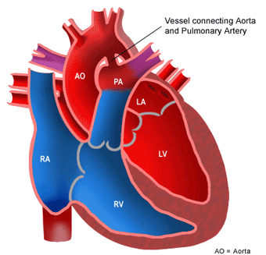
Ductus arterioses

Slide 34
CLINICAL ASPECTS:
Infants receiving formula diets low in fat developed skin symptoms that were cured by giving linoleate.
Patients maintained for long periods exclusively by intravenous nutrition low in essential fatty acids. It can be prevented by an essential fatty acid intake of 1-2% of the total caloric requirement.
Abnormal metabolism of essential fatty acids has been noted in cystic fibrosis, acrodermatitis enteropathica, hepatorenal syndrome, Sjogren-Larsson syndrome, multisystem neuronal degeneration, Crohn's disease, cirrhosis and alcoholism, Zellweger's and Reye's syndrome.
Thromboxanes are synthesized in platelets and upon release cause vasoconstriction and platelet aggregation. Their synthesis is inhibited by low-dose aspirin.

Slide 35
CLINICAL ASPECTS (cont.)
Prostaglandins (PGI2) are produced by blood vessel walls and are potent inhibitors of platelet aggregation.
Greenland Eskimos have low incidence of heart disease probably due to high intake of fish oils containing 20:5 w3 (EPA, or eicosapentaenoic acid), which gives rise to the series 3 prostaglandins (PG3) and thromboxanes (TX3). PG3 and TX3 inhibit the release of arachidonate from phospholipids and the formation of PG2 and TX2.
Mixture of leukotrienes C4, D4, and E4 are 100-1000 times more potent than histamine or prostaglandins as a constrictor of the bronchial airway musculature.
Leukotrienes are vasoactive, and 5-lipoxygenase has been found in arterial walls.

